Slide 1

Java Lambda Expressions
An interface which has only one abstract method is called functional interface. Java provides an anotation @FunctionalInterface, which is used to declare an interface as functional interface.
Lambda expression provides implementation of functional interface.
Why we use Lambda Expression?
1.To provide the implementation of Functional interface.
2.Less coding.

Slide 2
Java Lambda Expressions
Java Lambda Expression Syntax
(argument-list) -> {body}
Java lambda expression is consisted of three components.
1) Argument-list: It can be empty or non-empty as well.
2) Arrow-token: It is used to link arguments-list and body of expression.
3) Body: It contains expressions and statements for lambda expression.

Slide 3
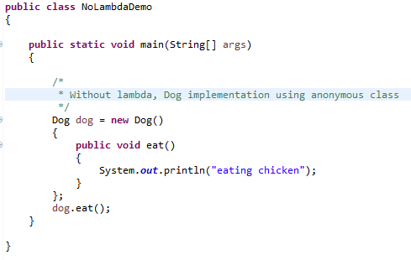
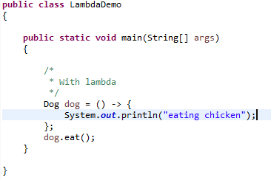
Java Lambda Expressions

Slide 4
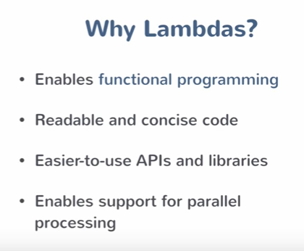
Java Lambda Expressions
Lambda expression is a new and important feature of Java which was included in Java SE 8. It provides a clear and concise way to represent one method interface using an expression. It is very useful in collection library. It helps to iterate, filter and extract data from collection. Before lambda expression, anonymous inner class was the only option to implement the method.
In other words, we can say it is a replacement of java inner anonymous class. Java lambda expression is treated as a function, so compiler does not create .class file.
Java lambda expression can be used in the collection framework. It provides efficient and concise way to iterate, filter and fetch data.

